Slide 1
How to administrate Identities and Groups in Microsoft 365
Speaker name

Slide 3
Overview of Identities in Microsoft 365

Slide 4
Overview
This lesson discusses the administration of users, and groups, including the following:
Overview of Microsoft 365 Identities
The various methods that can be used to create users and groups
The process to recover accidently deleted users

Slide 5
Objectives
After completing this lesson, you will be able to:
The various methods that can be used to create users and groups
Create, edit, delete, and recover a user
Assign permissions to users for service specific functions
Create and manage security groups

Slide 6

Microsoft Azure Active Directory
What it is:
The identity platform behind Microsoft 365 and other Microsoft Cloud Services
Can interoperate with enterprise identity platforms
An enabler of single sign-on for Microsoft 365 and other apps
What it is not:
Azure Active Directory(Azure AD) is not your Active Directory Domain Controllers running in Azure
Microsoft supports Active Directory running as a role on virtual machines in Azure infrastructure as a service (IaaS) – but that is a separate discussion

Slide 7

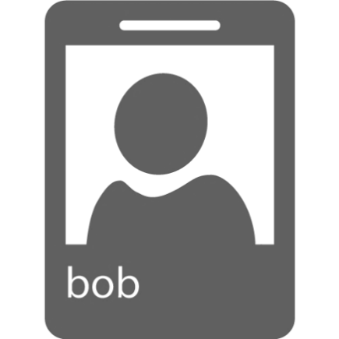
Cloud Identity
Microsoft Azure
Authentication
Microsoft 365 Admin Portal
Azure AD
OAuth2
Office Activation Service
Metadata
SAML-P
Authorization
Exchange Mailbox Access
Graph API
WS-Federation
…
CSV Import
Spreadsheet
Notes:
Single Cloud Identity suitable for small and medium organizations with no significant need for on-premises Active Directory or applications.
Users authenticate with Microsoft 365 where their O365 identity is

Slide 8
Directory and Password Sync
Microsoft Azure
Authentication
Microsoft 365 Admin Portal
Azure AD
OAuth2
1
Office Activation Service
Metadata
SAML-P
Authorization
Exchange Mailbox Access
2
Graph API
WS-Federation
…
On-premises
Directory Synchronization
(Azure AD Connect)
Active Directory
Notes:
Users authenticate with Microsoft 365 using the same user name and password they have in their on-premises Active Directory
The simplest way to enable authentication for on-premises directory objects in Azure AD. With password hash sync (PHS), you synchronize your on-premises Active Directory user account objects with Microsoft 365 and manage your users on-premises. Hashes of user passwords are synchronized from your on-premises Active Directory to Azure AD so that the users have the same password on-premises and in the cloud. When passwords are changed or reset on-premises, the new password hashes are synchronized to Azure AD so that your users can always use the same password for cloud resources and on-premises resources. The passwords are never sent to Azure AD or stored in Azure AD in clear text.

Slide 9
Federated Identity
Microsoft Azure
Microsoft 365 Admin Portal
Azure AD
OAuth2
Office Activation Service
Metadata
SAML-P
Authorization
Exchange Mailbox Access
Graph API
WS-Federation
…
On-premises
Authentication
Azure AD Connect
1
Active Directory Federation Services
(AD FS)
Active Directory
2
Notes:
Single Federated Identity and credentials suitable for medium and large organizations.
Users are authenticated against on-premises Active Directory via ADFS
This slide illustrates AD FS authentication taking place against on-premises Active Directory.

Slide 10
Administrating Identities in Microsoft 365

Slide 11
Creating or Editing Users
Create, edit, and license users individually or in bulk:
From the Microsoft 365 Admin Center
From a comma-separated Value (CSV) file
Through Windows PowerShell
Through Directory Synchronization
Notes:
Note: AAD Connect, does not currently perform license assignment.

Slide 12
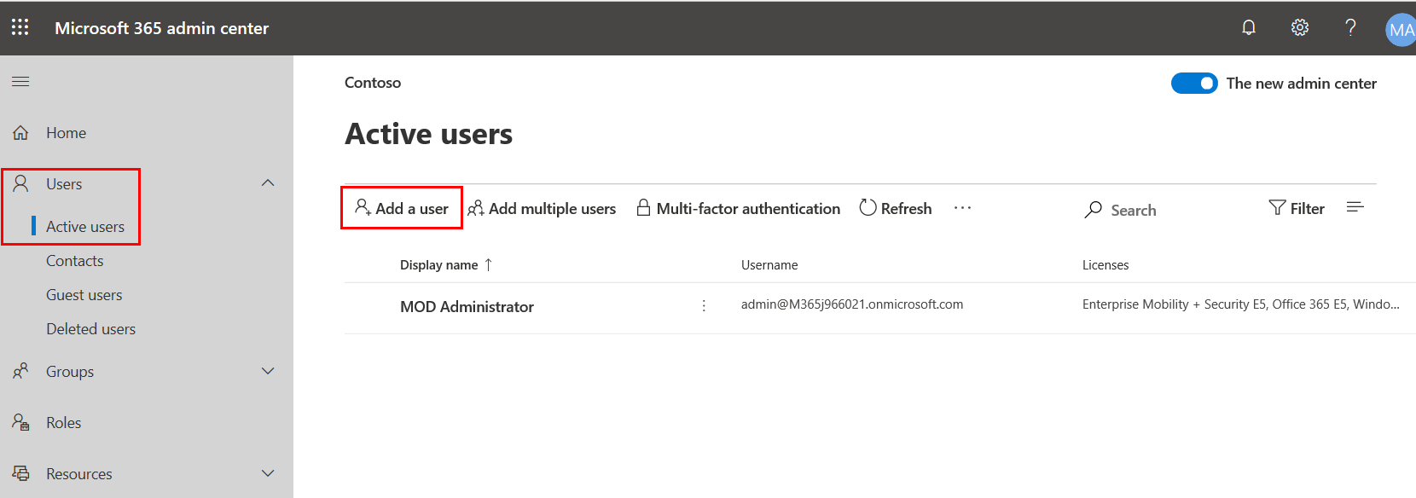
Creating Users Through Microsoft 365 Admin Center
Notes:
Create or edit users
As an Microsoft 365 admin, you need to create a user account for everyone in your organization who uses Microsoft 365 services. When you create or edit a user account, you can also assign licenses to the user and set a user’s administrative permissions. You can also delete an account if it is no longer needed.
For more info, refer to: https://support.office.com/en-us/article/Add-users-individually-to-Office-365---Admin-Help-1970f7d6-03b5-442f-b385-5880b9c256ec?ui=en-US&rs=en-US&ad=US

Slide 13
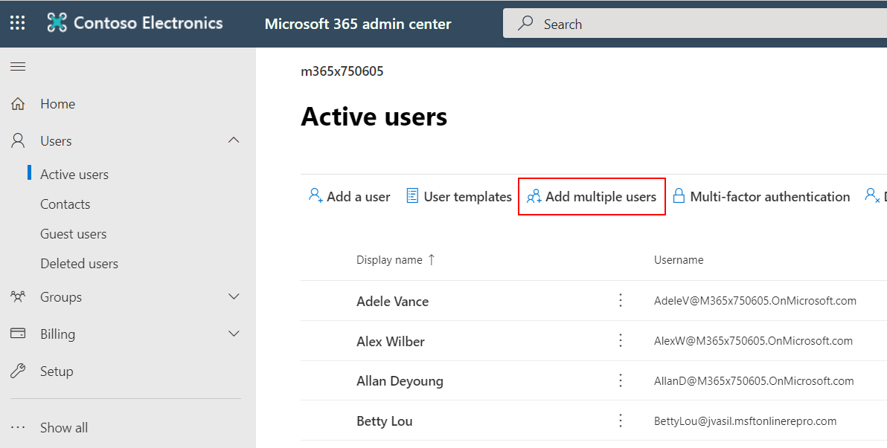
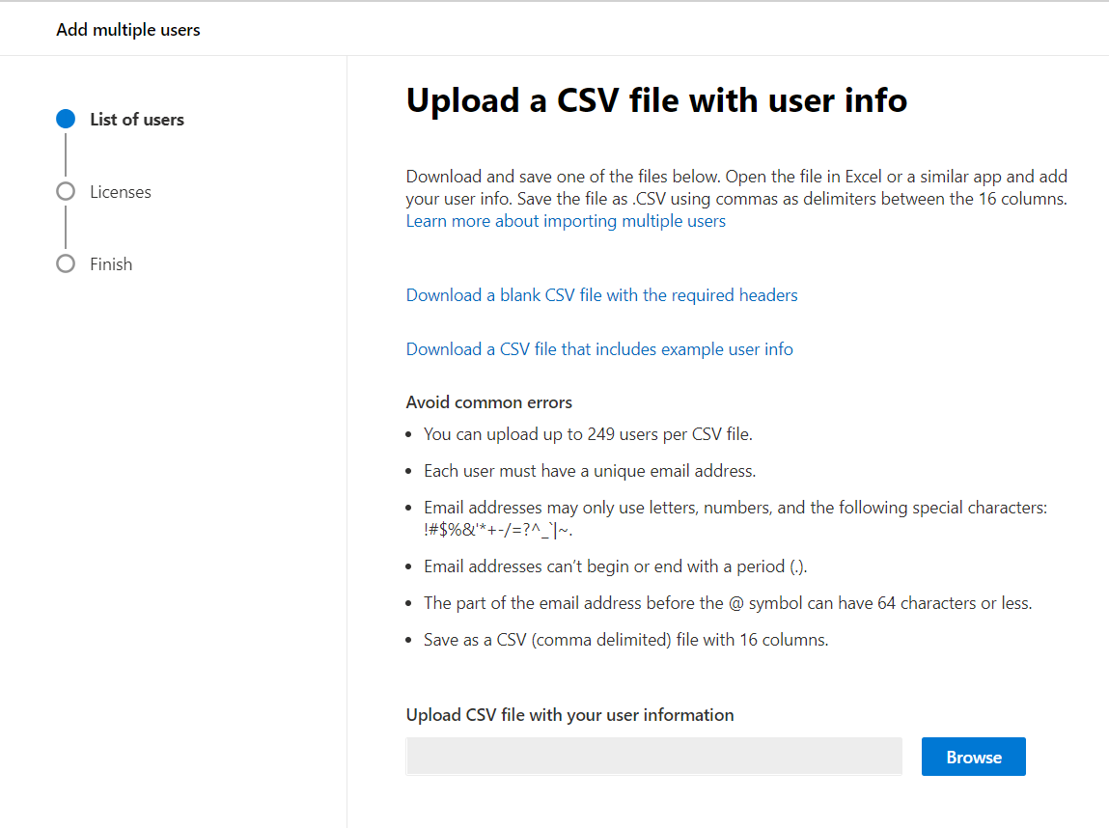
Adding Multiple Users with a CSV File
CSV Template is provided on the Microsoft 365 Admin Center
Notes:
Add multiple users with a comma-separated Value (CSV) file
You can bulk add user accounts into Microsoft 365 with a CSV file. This allows you to add multiple users at the same time.
Go to Admin Center> Users > Active Users.
Click Bulk add.
https://support.office.com/en-us/article/Add-several-users-at-the-same-time-to-Office-365---Admin-Help-1f5767ed-e717-4f24-969c-6ea9d412ca88?ui=en-US&rs=en-US&ad=US
The wizard takes you through the steps for adding a group of users at once. Be sure that you include (at a minimum) a complete email address (such as bob@contoso.com) and a display name (such as Bob Kelly) in your CSV file for each user. All column headings are required. Users are not added until you finish going through all the steps of the wizard.
The best way to learn about the CSV format is to use the blank template or sample CSV file:
Download the file: Click Admin, click Users and Groups, and then click Bulk add. On the first page of the Bulk add users wizard, click the download link.
Edit the file: You can edit the file in a text editor, such as Notepad.
Look at the format: The template contains the headings (the user data column label), which is the first row in the sample CSV file. You add each record (user) to a separate line under the heading. The sample file is an example of a correctly formatted CSV file, and you can replace the example data with your user information. It is important not to add, change, or delete any of the column headings or else Microsoft 365 might not be able to create users from the information in the file.
Separate values with commas: You must use a comma between each of the fields (user's first name, last name, and so on).
Save the file with a new name: Save the file with a new name for each CSV file that you create. Be sure to use the .csv file extension.
Tips for CSV Formatting
What if you do not have all the information required for each user?
The User Name and Display Name are required, and you cannot add a new user without this information. If you do not have some of the other information, such as Fax, you can use a space and a comma to indicate that the field should remain blank.
How small or large can the CSV file be?
The CSV file must have at least two rows. One is for the column headings (the user data column label) and one for the user. You cannot have more than 251 rows. If you need to import more than 250 users, you can create more than one CSV file.

Slide 14
Creating Users using Windows PowerShell
User management common cmdlets:
Get-AzureADUser
New-AzureADUser
Remove-AzureADUser
Set-AzureADUser
Set-AzureADUserLicense
Set-AzureADUserPassword
Set-AzureADUserPrincipalName
New-AzureADUser -UserPrincipalName john@contoso.com -DisplayName "John Smith" -LicenseAssignment "contoso:ENTERPRISEPACK" -UsageLocation "US" -Password "Password1"
Notes:
The Get-AzureADUser cmdlet can be used to retrieve an individual user, or list of users. An individual user will be retrieved if the ObjectId or UserPrincipalName parameter is used.
The New-AzureADUser cmdlet is used to create a new user in the Microsoft Online directory. To give the user access to services, they must also be assigned a license by using the LicenseAssignment parameter.
The Remove-AzureADUser cmdlet is used to remove a user from the Microsoft Online directory. This cmdlet will delete the user, their licenses, and any other associated data.
The Set-AzureADUser cmdlet is used to update a user object. Note that this cmdlet should be used for basic properties only. The licenses, password, and User Principal Name (UPN) for a user can be updated by using the Set-AzureADUserLicense, Set-AzureADUserPassword, and Set-AzureADUserPrincipalName cmdlets respectively.
The Set-AzureADUserLicense cmdlet can be used to adjust the licenses for a user. This can include adding a new license, removing a license, updating the license options, or any combination of these actions.
The Set-AzureADUserPassword cmdlet is used to change the password of a user. This cmdlet can only be used for users with standard identities.
The Set-AzureADUserPrincipalName cmdlet is used to change the User Principal Name (user ID) of a user. This cmdlet can be used to move users between a federated and standard domain, which will result in their authentication type changing to that of the target domain.

Slide 15
Deleting Users
You can delete Microsoft 365 user accounts by using any one of the following ways:
By using the Microsoft 365 Admin Center
By using Windows PowerShell
A directory synchronization filtering change excludes on on-premises Active Directory user object from the synchronization set
Through a synchronized deletion if the on-premises user object from the on-premises Active Directory
Deleted user accounts and data (that is, OneDrive for Business and Mailbox) can be restored within 30 days (by Default)
Before restoring a deleted user, an available user license is required

Slide 16
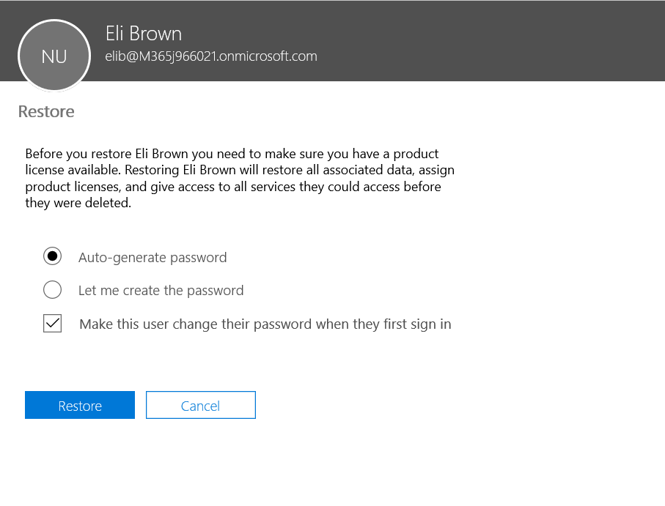
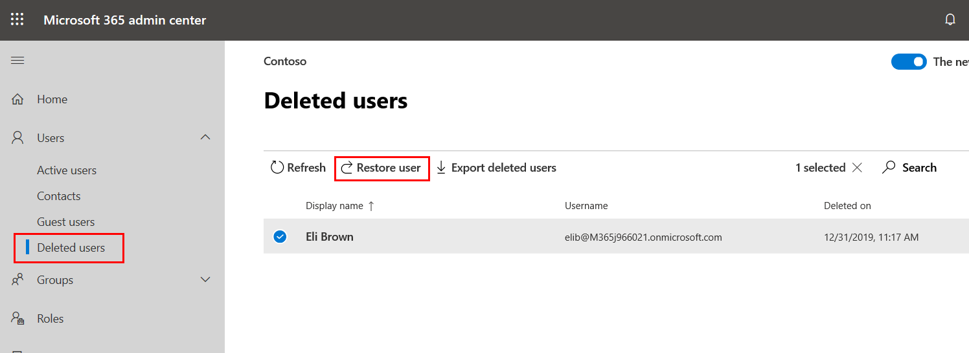
Restoring a Cloud User Account
Notes:
In Microsoft 365, accounts can be restored within 30 days of deletion by using the Restore Users option on the Deleted Users page.

Slide 17
Administrating Security Groups in Microsoft 365 - Security Groups

Slide 18
Security Groups
There are two places where security groups can be created in Microsoft 365, both of which serve a different purpose
A Security Group created in the Microsoft 365 Admin Center is used to grant access to specific SharePoint Online resources only
You also can manage these groups by using the Microsoft 365 Admin Center or the Azure Active Directory module for Windows PowerShell
A Mail-enabled Security Group can be used to distribute messages to group members and to grant access permissions to SharePoint Online and OneDrive for Business
You can manage these groups only by using the Microsoft 365 Admin center and PowerShell
Notes:
Security groups created on-premises will replicate to Microsoft 365 by using DirSync. These security groups will appear only in the Microsoft 365 Admin Center and not in the Exchange Admin Center.
Mail-enabled security or distribution groups created on-premises will replicate by using DirSync to Microsoft 365 and will appear in both the Microsoft 365 Admin Center (as read-only) and the Exchange Admin Center.

Slide 19
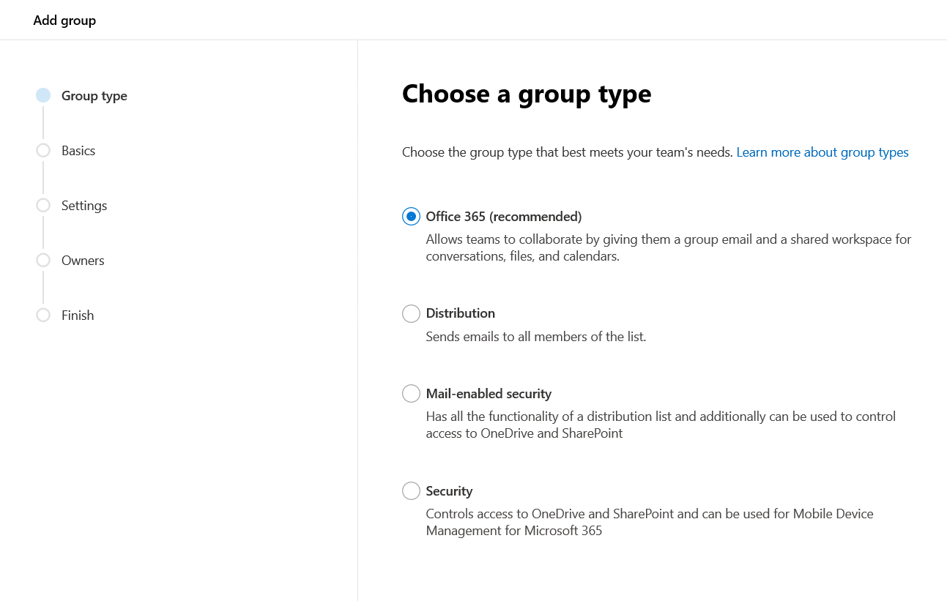
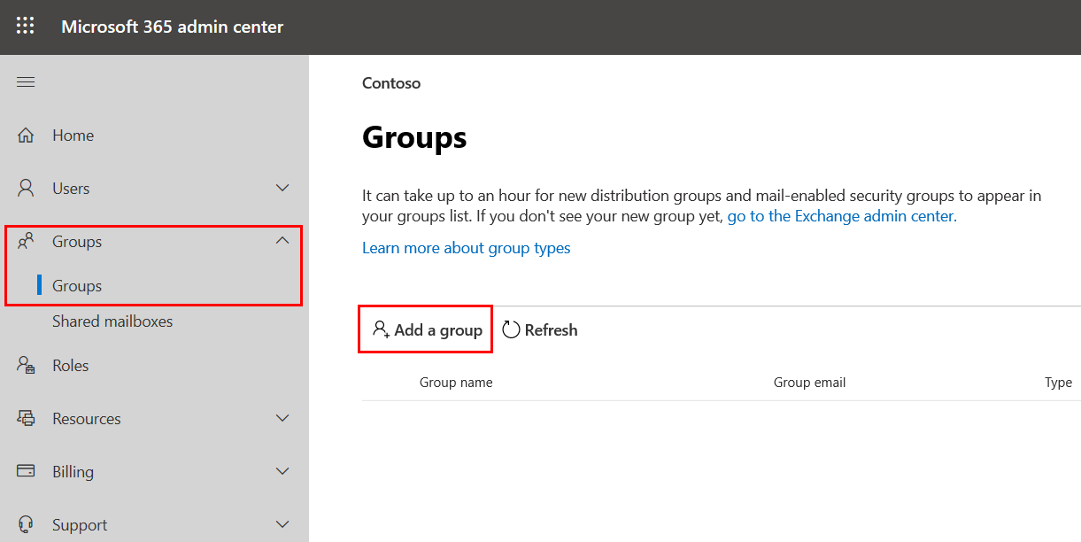
Creating Security Groups

Slide 20
Windows PowerShell Cmdlets Related to Group Management
Add-AzureADGroupMember
Get-AzureADGroup
Get-AzureADGroupMember
New-AzureADGroup
Remove-AzureADGroup
Remove-AzureADGroupMember
Set-AzureADGroup
Notes:
The Add-AzureADGroupMember cmdlet is used to add members to a security group.
The new members can be either users or other security groups.
The Get-AzureADGroup cmdlet is used to retrieve groups from Microsoft Online.
This cmdlet can be used to return a single group (if ObjectId is passed in), or to search within all groups.
The Get-AzureADGroupMember cmdlet is used to retrieve members of the specified group. The members can be either users or groups.
The New-AzureADGroup cmdlet is used to add a new security group to the Microsoft Online directory.
The Remove-AzureADGroup cmdlet is used to delete a group from the Microsoft Online directory.
The Remove-AzureADGroupMember cmdlet is used to remove a member from a security group. This member can be either a user or a group.
The Set-AzureADGroup cmdlet is used to update the properties of a security group.

Slide 21
Knowledge Check
What Microsoft’s identity platform behind Microsoft 365 and other Microsoft Cloud Services?
What is the Windows PowerShell cmdlet name that is used to create new users?
Within what time frame can deleted users be restored?
Azure Active Directory
New-AzureADUser
30 Days

Slide 22
Summary
In this lesson, you learned:
Different types of Identities in Microsoft 365
How to create users and groups by using the GUI and Windows PowerShell
How to recover deleted users and deal with attribute conflicts

Slide 23
Lab
Explore Microsoft 365 Tenant
Managing Identities in Microsoft 365

